Slide 1
Team Blitz Presents Flappy-Angry Bird
Developed By -
Abhin Sharma
Murtaza Manaswala
Vishwajeet Kharote
Jaykumar Patel
Harshrajsinh Rathod

Slide 2
Project Deliverables
Team’s UML Diagram
Final Task Board
Final Scrum Burndown Chart

Slide 3
UML Class Diagram

Slide 4
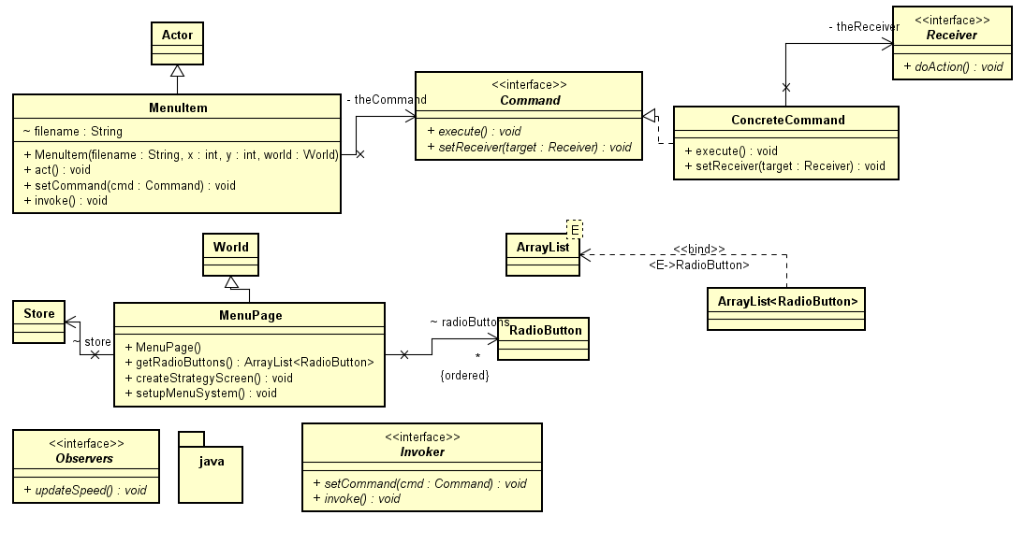
Command Pattern

Slide 5
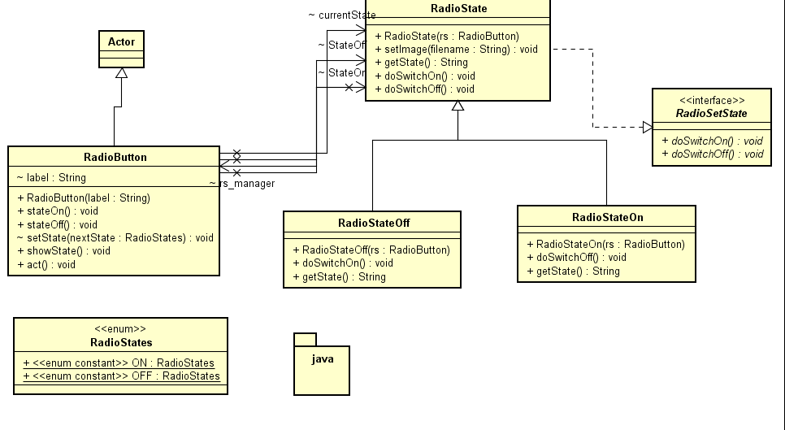
State Pattern

Slide 6
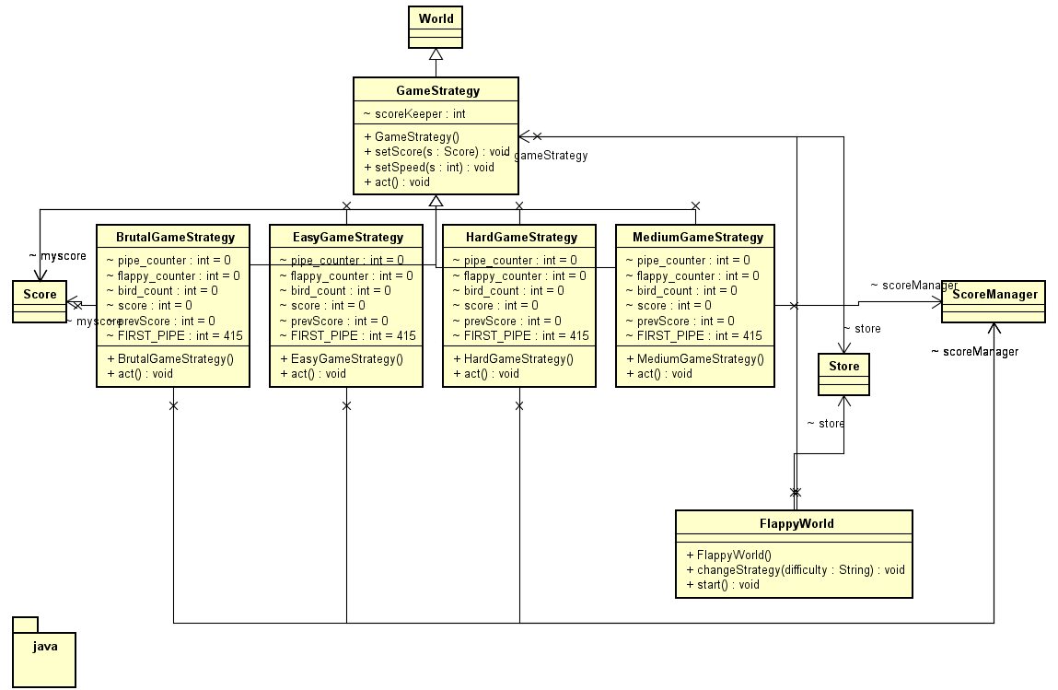
Strategy Pattern

Slide 7
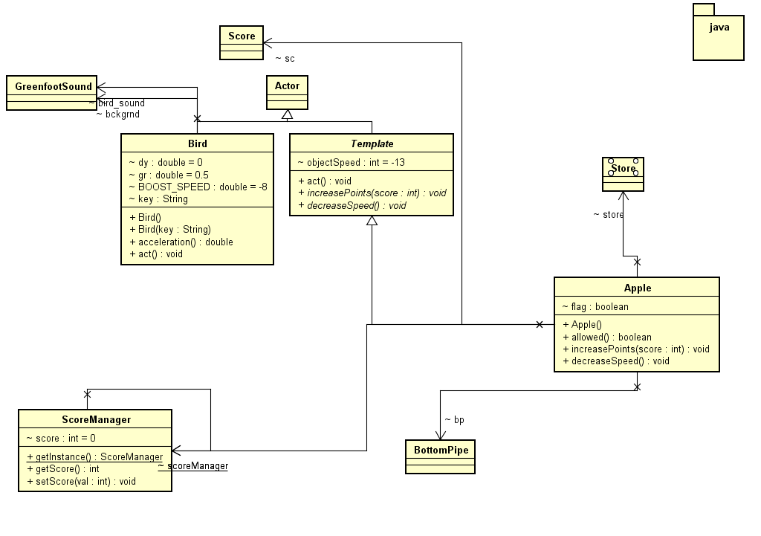
Template Pattern

Slide 8
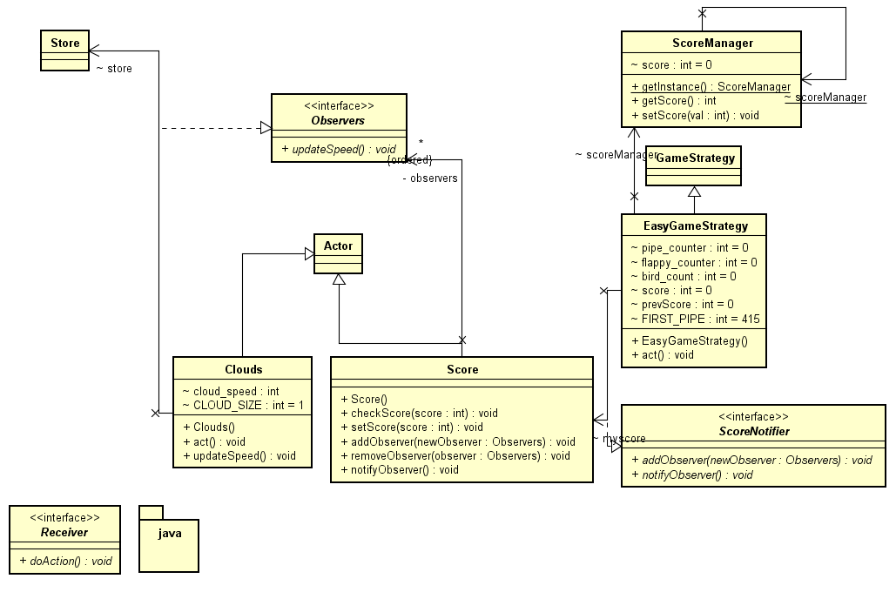
Observer Pattern

Slide 9
UML Sequence Diagram

Slide 10
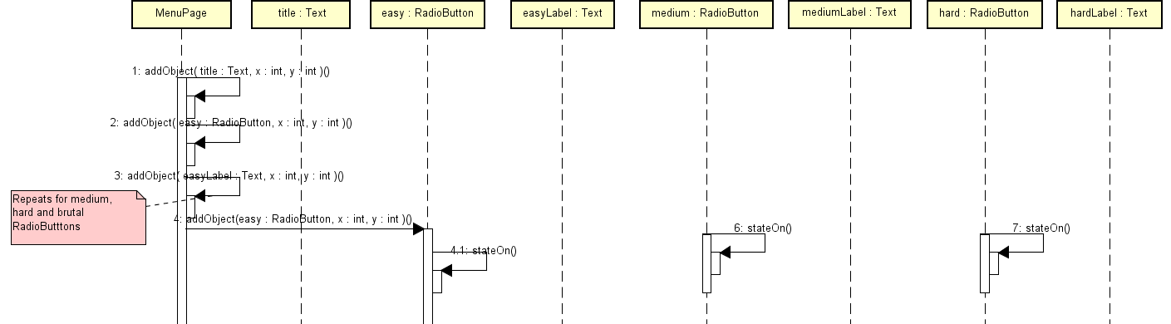

Slide 11
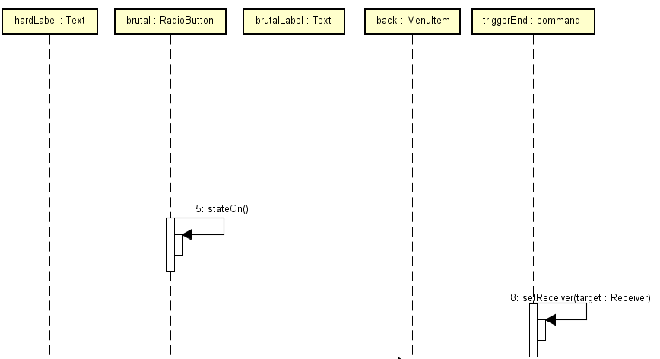

Slide 12
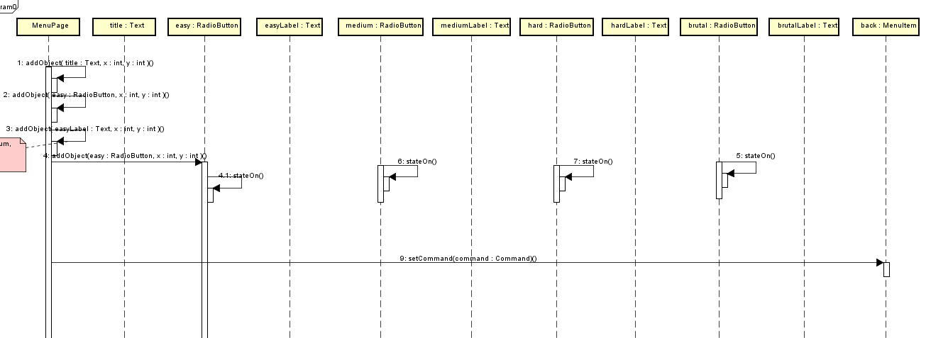

Slide 13
UML Activity Diagram

Slide 14
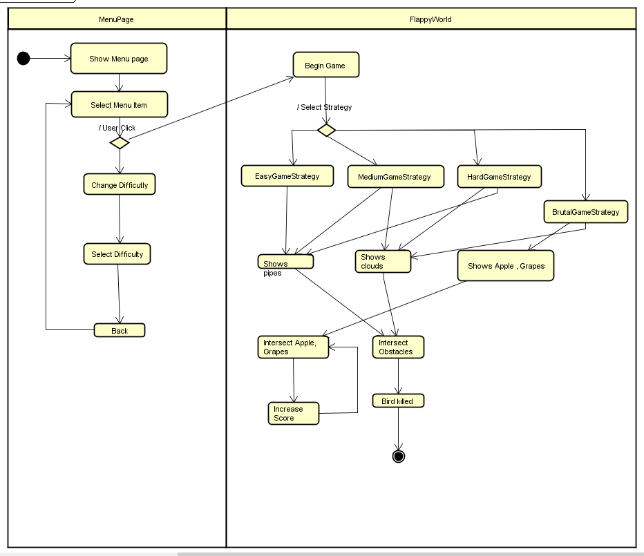

Slide 16
Use-Case Diagram

Slide 17
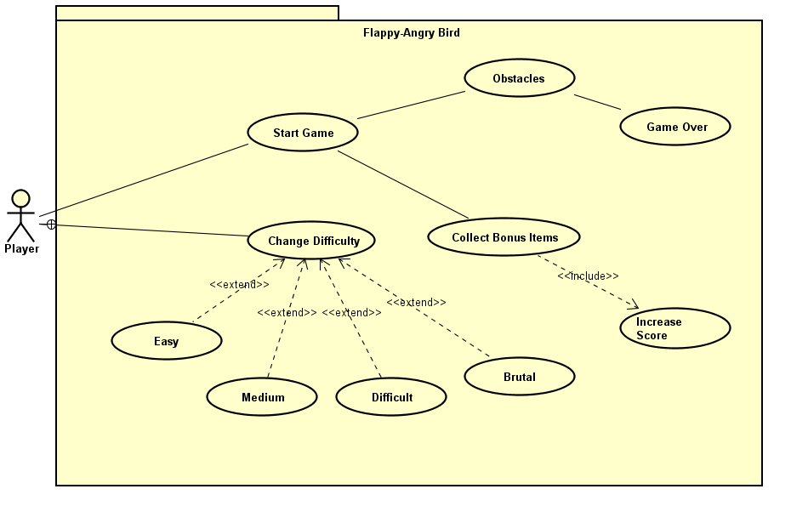

Slide 18
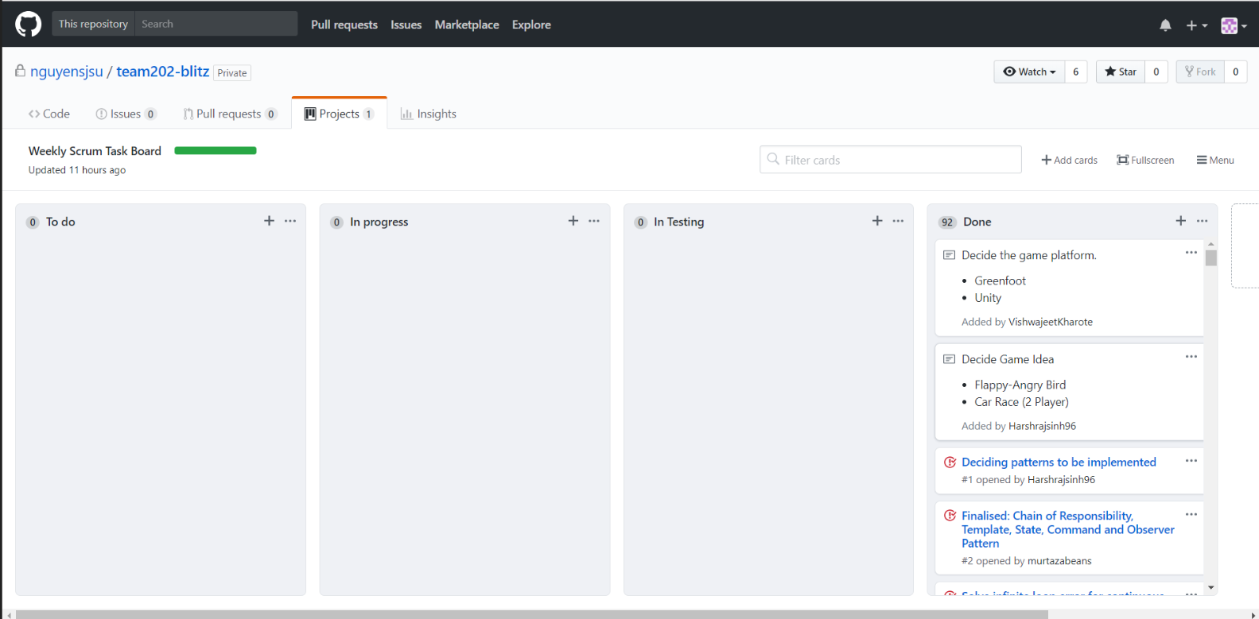
Final Task Board

Slide 19
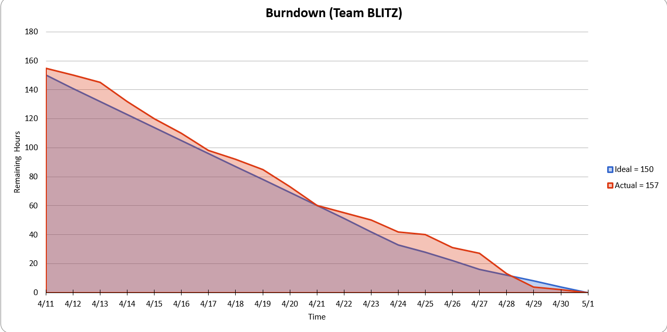
Final Scrum Burndown Chart

Slide 20
Game On!!!
GitHub Repo : https://github.com/nguyensjsu/team202-blitz
GitHub Task Board : https://github.com/nguyensjsu/team202-blitz/projects/2
YouTube link: https://youtu.be/6eKw4QWndFA

